Slide 1
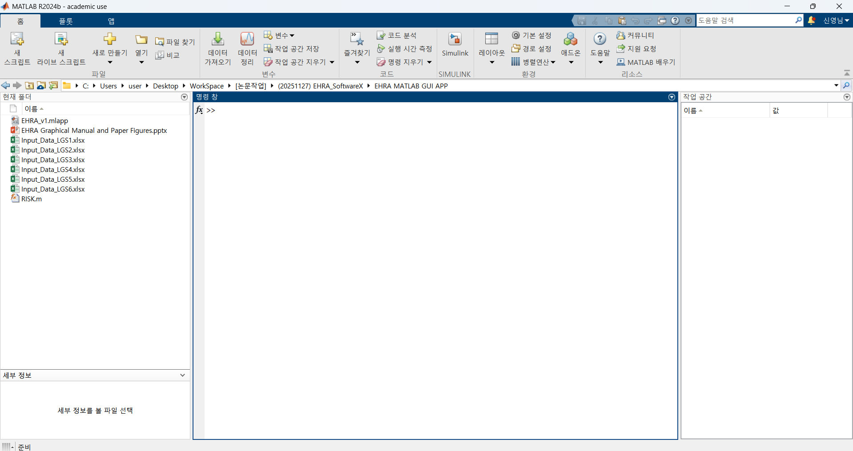
Click
or
Execute MATLAB App Designer

Slide 2
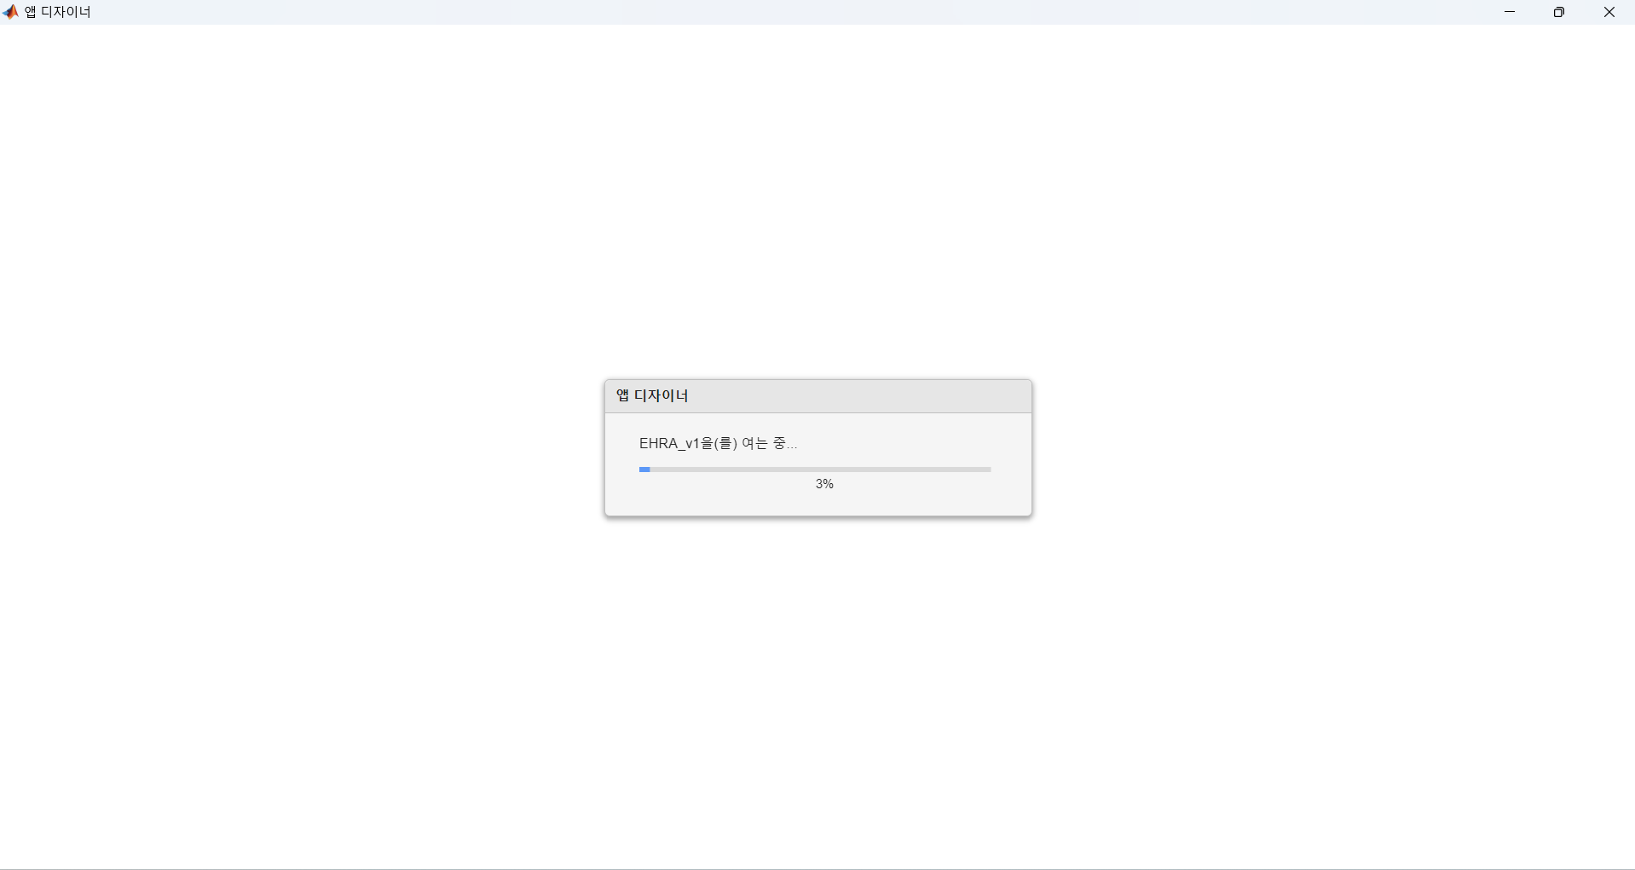

Slide 3
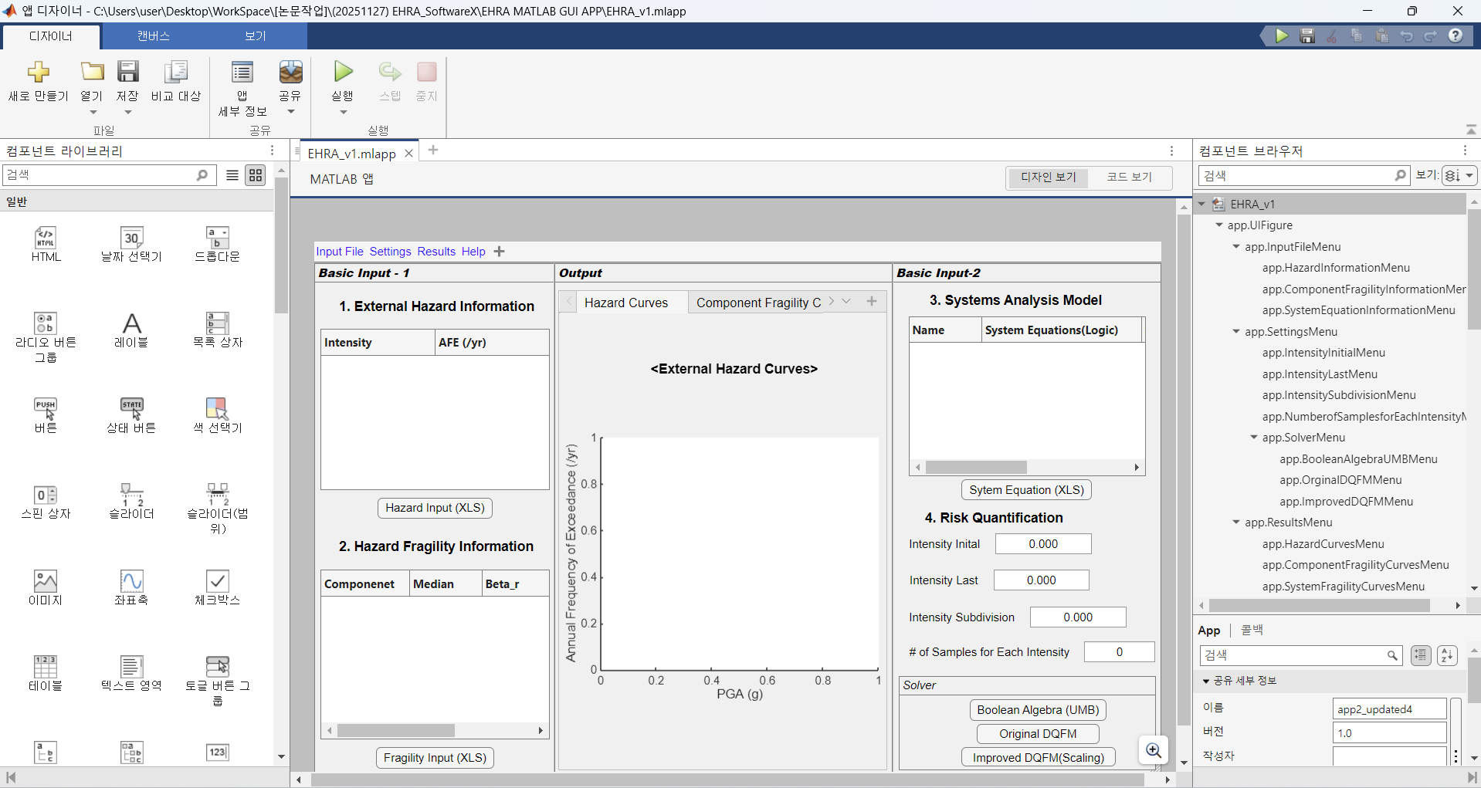
Click, and Confirm and Check Source Codes

Slide 4
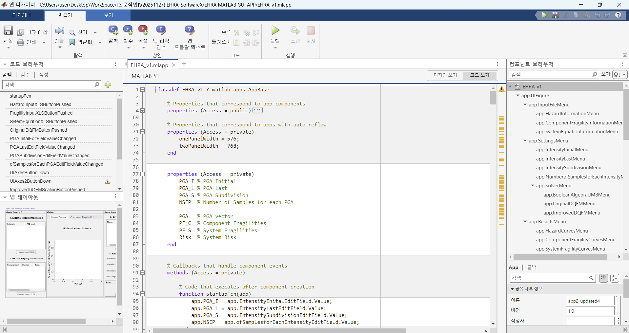

Slide 5
Click

Slide 6
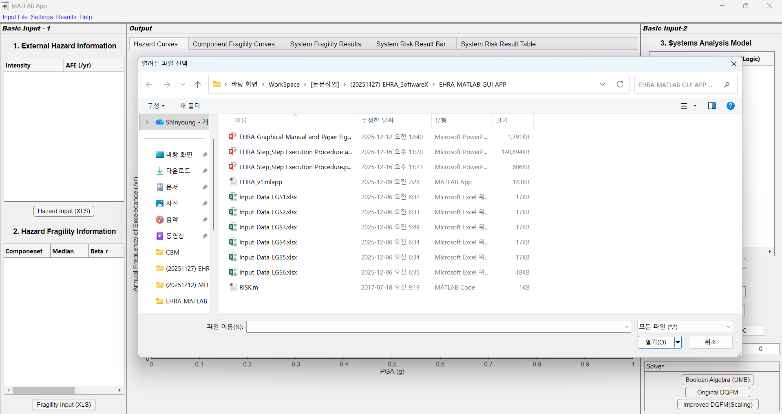
Click
Change all file types

Slide 7
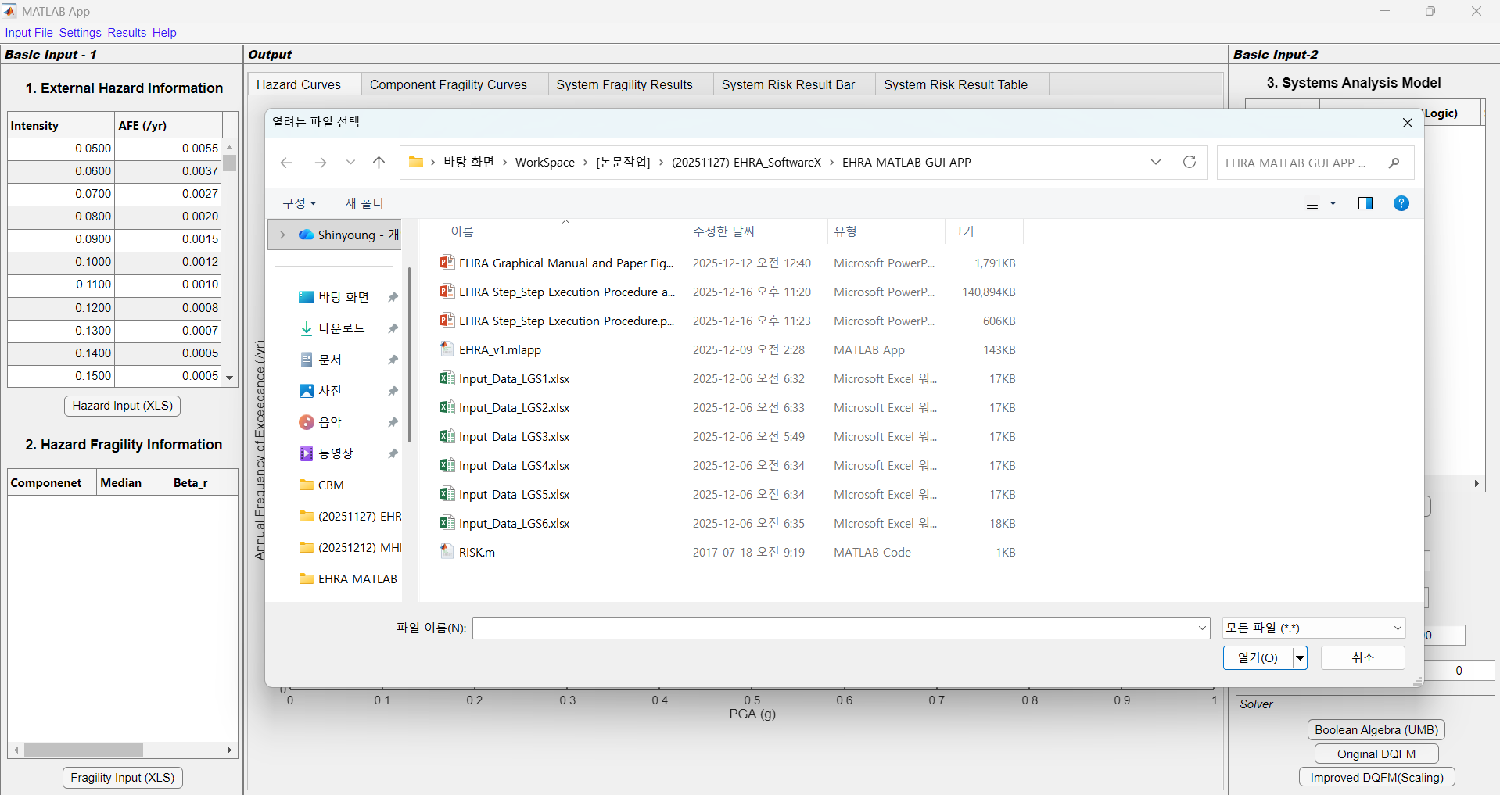
Change all file types
Click

Slide 8
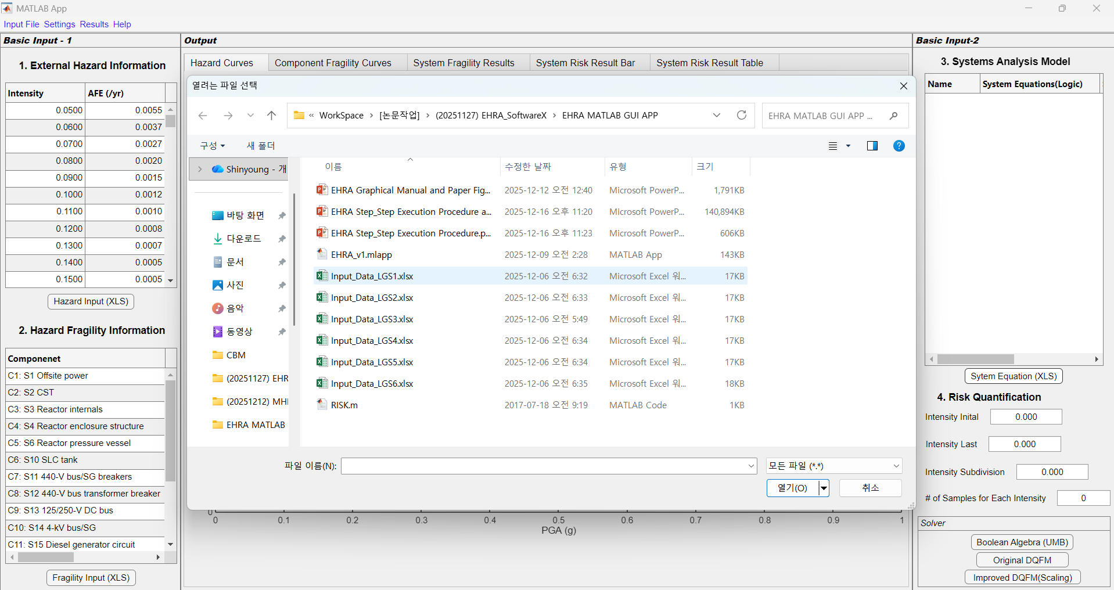
Click
Change all file types

Slide 9
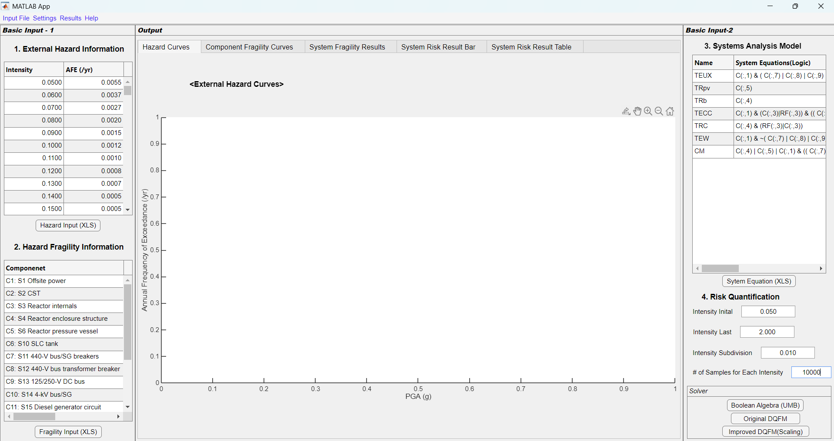
Manual Input and Click Solver

Slide 10
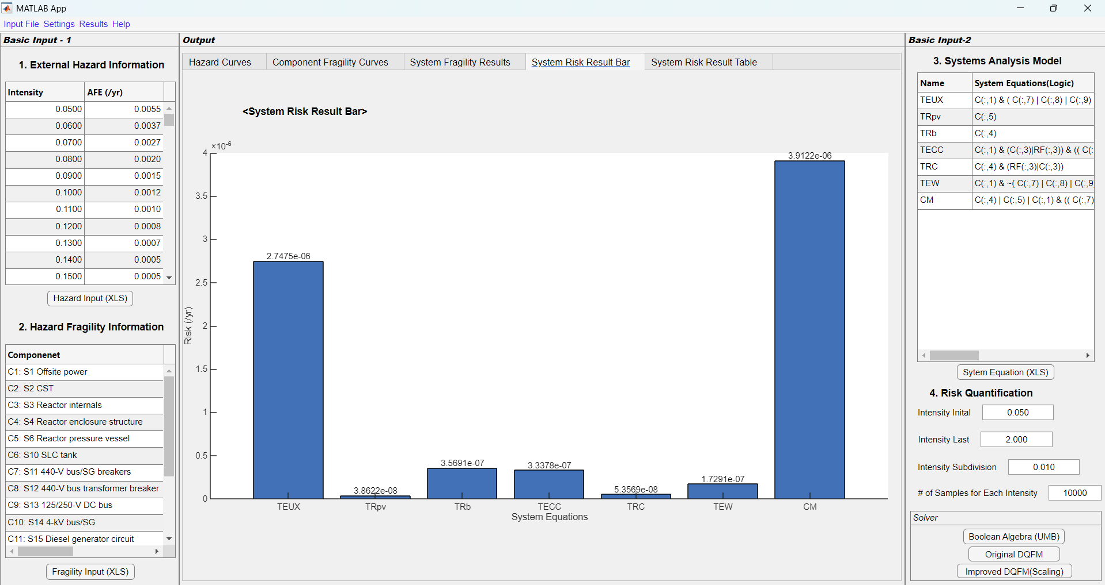
Check Results

